Slide 1
Growing Incredible Managers:
Business Models for Innovation and building accountability
Prepared by
Greg Mathers, Certified Adizes Senior Associate
June-July 2019
Projekts Nr./ CFLA līgums Nr. 1.2.2.3/16/i/001

Slide 2
Building Accountability
To Bring Your Business
Model To Life

Slide 3

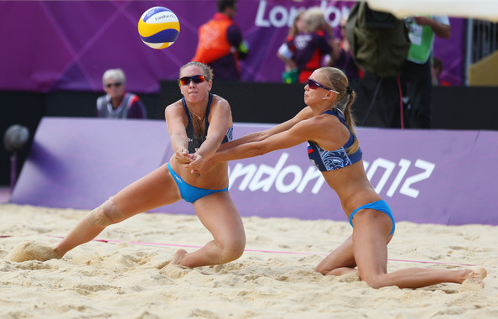
Responsibility
Accountability
Commitment
Engagement
…

Slide 4
I know what to do
I can do it
I will be rewarded

Slide 5
I know what to do
I can do it
I will be rewarded

Slide 6
I know what to do
I can do it
I will be rewarded

Slide 7
PERFORMANCE TRACKING SYSTEM
MISSION
STRUCTURE
REWARDS
ACCOUNTABILITY

Slide 8
PERFORMANCE TRACKING SYSTEM
MISSION
STRUCTURE
REWARDS
I know what to do
I can do it
I will be rewarded

Slide 9


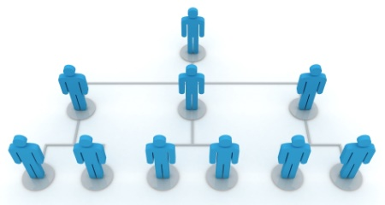
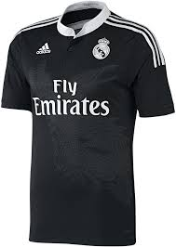
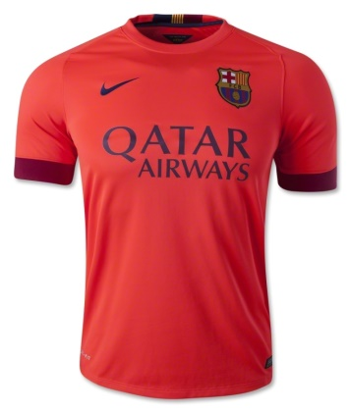
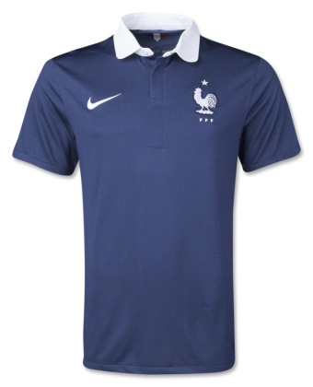
Syndag
Mission
Organizational
Structure
Actual
Plan
Objectives

Slide 10
Our tools to measure:
Blue book – planning
Red book - actual
Black book - objectives
KPIs +

Slide 11
Black book
"We are hitting the target but missing the point".

Slide 12
EVERY ORGANIZATION HAS FOUR SUBSYSTEMS
MISSION
CLIENT
INTERFACE
Who needs us?
TRANSFORMATION
How do we
provide it?
HUMAN
RESOURCES
Who does what?
FINANCIAL
RESOURCES
With which
planned resources?

Slide 13
EACH FUNCTIONAL SUBSYSTEM HAS DEVELOPMENTAL AND MAITENANCE COMPONENT
MISSION
CLIENT
INTERFACE
HUMAN
RESOURCES
FINANCIAL
RESOURCES
TRANSFORMATION
D
M
D
M
D
M
D
M

Slide 14
E
P
I
A
CLIENT
INTERFACE
TRANSFORMATION
HUMAN
RESOURCES
FINANCIAL
RESOURCES
EI
PA
EI
PA
EI
PA
EI
PA
D
M
D
M
D
M
D
M

Slide 15
TASKS
OBJECTIVES
GOALS
MISSION
EVERY MISSION HAS AT LEAST 4 GOALS
EVERY GOALS HAS MORE OBJECTIVES
EVERY OBJECTIVE HAS MORE TASKS

Slide 16
Mission Priority Setting First identify WHAT can be done in CUSTOMER INTERFACE: WHAT are the OPPORTHREATS? Then analyze HOW it could be done – Do we have the knowledge and capability? TRANSFORMATION Then analyze WHO could do it- are the HUMAN RESOURCES available? Next, identify WHEN it could be done and whether the FINANCIAL RESOURCES are available.

Slide 17
The Black Book
Inspect Vs. Expect
Management Control Vs. Ambiguity
The Tools
Job Description
Performance Objectives
Key Performance Indicators

Slide 18
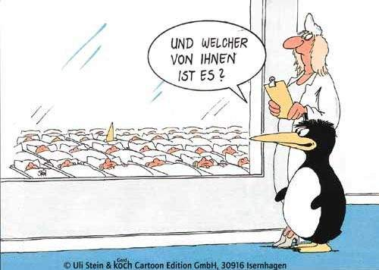
Select significant KPIs
Which one
Is mine?

Slide 19
Number of students
Revenue per student
Revenue per program
Students per program
Faculty with PhDs
Number of ‘A’ level publications
Matriculation rate

Slide 20
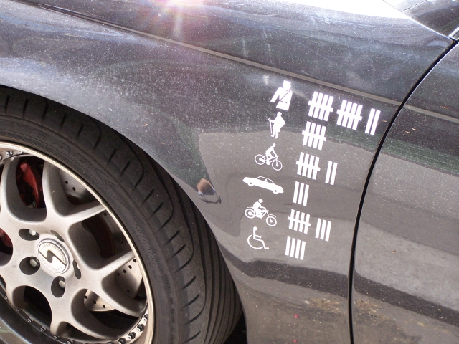
KPIs are a must

Slide 21
The Black Book
Inspect Vs. Expect
Management Control Vs. Ambiguity
The Tools
Job Description
Performance Objectives
Key Performance Indicators

Slide 22
The four Imperatives
What (and Why)
How
When
Who

Slide 23
The WHAT and Why

Slide 24
For what purpose Explain why you decided to put yourself a objective / sub-objective. What reason? Usually we can refer to the corporate GOALS. CI - Relationship with the Customer? T - for Transformation? HF - for the Human Factor? FF - for the Financial Factors? D - for Development and M - for Maintenance
Notes:
D – Development, M – maintenance (Цель – из Миссии, Подцели – это цели подразделений)

Slide 25
USE ACTIVE verbs to determine WHAT you want to do: Increase, Decrease, Improve, Create, Develop, Explore, etc.

Slide 26

SMARTS
S - Specific
M – Measurable
A – Achievable
R – Realistic
T – Time Bound
S - Stretched

Slide 27
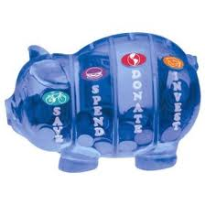
CATEGORIZING Objectives USING PAEI
“P” OBJECTIVE - activities aimed at fulfilling the purpose for which the unit or organization exists - i.e. The provision of the product, service or function. A Functional objective, bringing Short Term Effectiveness to the organization.
Notes:
Changed - 6/25/01

Slide 28
CATEGORIZING Objectives USING PAEI
“A” OBJECTIVE - administrative activities for organizing, controlling and monitoring activities. An Administrative objective, bringing Short Term Efficiency to the organization.
Notes:
Changed - 6/25/01

Slide 29
CATEGORIZING Objectives USING PAEI
“E” OBJECTIVE - activities undertaken now for the unit or organization to be different in the future - i.e. Marketing, research, field trials, HRD, Financial Planning. A Developmental objective, bringing Long Term Effectiveness to the organization.
Notes:
Changed - 6/25/01

Slide 30
CATEGORIZING Objectives USING PAEI
“I” OBJECTIVE - activities aimed at the organic integration of the enterprise - i.e. Teambuilding, employee events, employee relations, Adizes or similar programs. An Integrative objective bring Long Term Efficiency to the organization.
Notes:
Changed - 6/25/01

Slide 31
Deterministic & Constraint
There are two types of WHAT
Deterministic – What do you want
Constraint – What do you not want
Notes:
ОГРАНИЧЕНИЯ накладываются, чтобы достижение одной цели не было в ущерб другой
Цели (организации), Подцели (Подразделений)

Slide 32
The Pressure Cooker of Expectations
Superiors
YOU
Peers
Peers
Subordinates

Slide 33
Style Enrichment
Each employee must have at lease one objective from each of the PAEI.

Slide 34
The HOW

Slide 35
MEASURABLE
In order for an objective to be performed it must be MEASURABLE. Thus, reducing ambiguity and insuring clarity.

Slide 36
VERIFIABLE
If the objective / subobjective is NOT MEASURRABLE, please provide criteria that will allow you to VERIFY that the objective / subobjective has been achieved.
Notes:
Должно быть «измеримое» понимание у руководителя, как он поймет, что цель достигнута

Slide 37
The WHEN

Slide 38
Time Bound
Time should be expressed as a date.
Avoid ASAP.
Tolerable level of frustration.

Slide 39
The WHO

Slide 40
The contract between the employee and manager

Slide 41
Co

Slide 42
Reality Test COST of achievement of the objective / subobjective and whether the costs were budgeted

Slide 43

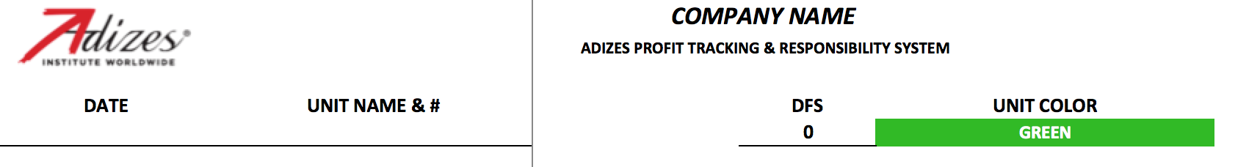
Company & Unit information
Company Name
Date: Specify the date for which the Black Book is valid until.
Unit Name & #:
DFS: It stands for Distance From Source and it identifies the number of levels that exist between your unit and the client. This only applies if your unit is Green or Blue, otherwise please type “N/A”.
Unit Color:

Slide 44

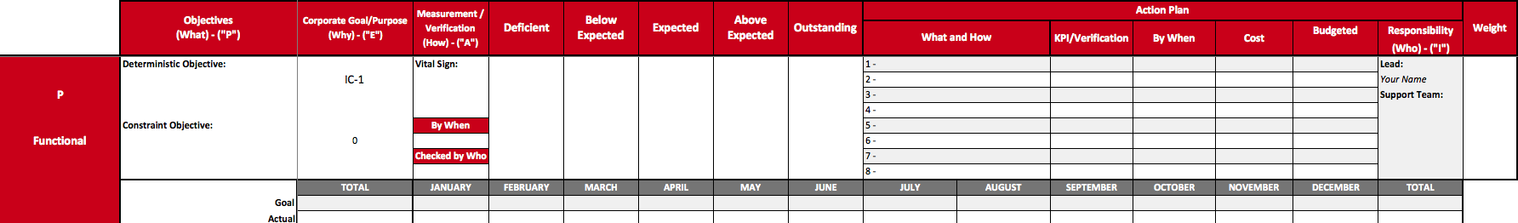
Deterministic objective
This is the objective that you are committing to achieve, it describes the desirable outcome
Be as specific as you can with the kind of goal
Increase year sales
Decrease “X” indicator to “Y” level by “Z” date
Increase year average of “X” indicator to “Y” level
Increase year sales to 15.2 MUSD
Decrease monthly average delivery time to 36 hours by April.
Open a new office in northern region

Slide 45
Constraint objective
It describes what should not be violated while the deterministic objective gets accomplished.
Some times the options might not be obvious but there is always something that can be affected.
“What could get affected as a secondary effect of trying to accomplish this objective?”
Deterministic Objective: Increase sales by 25% (to 6.7 MUSD)
Constraint Objective: Without lowering gross margin of 32%
Deterministic Objective: Increase service level year average to 90%
Constraint Objective: Without increasing the inventory to more than 1.5 MUSD

Slide 46
Corporate Goal or Purpose
Each personal objective should be aligned to a corporate goal.
If you believe that an objective that you have is not aligned to any corporate goal please align it to the closest one or please use the cell to describe why do you believe is important.

Slide 47
KPI or Verification
It is very important to define how to make sure that the objective is accomplished.
When the objective can be measured, an appropriate KPI needs to be selected.
When the objective can’t be measured, then it is necessary to express the way it will be verified.

Slide 48
By When and Checked by Who
Every objective must state the time frame for its expected completion. It should be expressed as a date (day, month and year).
Please specify who should be responsible of validating weather the objective was accomplished or not.

Slide 49
Range of Acceptance
The range of acceptance is broken into five segments:
O - Overachieve
AE – Above expected
E – Expected
BE – Below expected
D – Deficient

Slide 50
 | D | BE | E | AE | O
Sales of New Product | $60 | $80 | $100 | $120 | $140
Sales of Mature Product | $95 | $98 | $100 | $103 | $106
 | D | BE | E | AE | O
Launch New Product | 15-Sep-17 | 10-Aug-17 | 15-Jul-17 | 20-Jun-17 | 10-May-17

Slide 51
Plan of Action
The Action Plan represents the strategies that the owner of the Black Book is planning to implement in order to make the expected result happen.
KPI/Verification: the measurement or verification mechanism
By When: By when should that specific line be accomplished?
Cost: Is there a cost associated with that line?
Budgeted Yes/No: In the event that there is a cost, please specify if there is already a budget for it or not.
Responsibility: You are the main responsible, nevertheless please identify if you need support from somebody else in order to accomplish your objectives.
Adize

Slide 52
Weight
Not every objective has the same importance;
Express as a percentage the weight that each particular objective has. The sum of all of them should at 100%.

Slide 53
Types of Objectives
“P” Objectives: Functional objectives that produce results in the short term. Such objectives could be closing a pending contract, renewing a line of credit, surpassing a sales quota, reducing costs, etc.
“A” Objectives: Administrative objectives that increase efficiency in the short term. These objectives will include introduction of efficiency measures, which benefit from the implementation of routines, processes and systems, such as a uniform expense reports, review of financial data on timely bases, performance evaluation of personnel, etc.

Slide 54
Types of Objectives
“E” Objectives: Developmental objectives that impact long term effectiveness of the organization. These objectives will focus on the development or creation of something new, a change. These objectives will draw upon, or drive on the creative nature of the position. Such objectives will include product development, development of new markets, design of a new system or process, research, etc.
“I” Objectives: Integration objectives that will promote team building and affinity within the organization thus increasing its long-term efficiencies. Objectives in this category will include personnel development and training, staff outings, internal promotion of individuals, etc.

Slide 55
The Monthly Plan / Scorecard
Enable the proper tracking of the objectives and to potentially fine-tune
Start by writing what your Deterministic objective is and then write on the “Goal” line how you expect the result or KPI to behave through the year.
If the objective is measurable please indicate the expected result of the KPI for that specific month.
If the objective is verifiable then place an “X” on the month in which you expect the result to happen.
Take into consideration business cycles and your action plan.
Adize

Slide 56
Need to / Nice to
Adize

Slide 57
Goals and Objectives
Short term effective - objectives that provide value. Such objectives could be closing a pending contract, renewing a line of credit, surpassing a sales quota, etc.
Short term efficiency: objectives that increase efficiency in the short term. These objectives will include implementation of routines, processes and systems, such as a common expense reports, review of financial data on timely bases, performance evaluation of personnel, etc.

Slide 58
Types of Objectives
Long term effectiveness: Developmental objectives that focus on creating something new or a change. These objectives require creativity and risk taking. objectives will include product development, entering new markets, design of a new system or process, research, etc.
Long term efficiency: Objectives that will promote team building and alignment within the organization. Objectives in this category will include personnel development and training, staff outings, internal promotion of individuals, etc.

Slide 59
Goals & Objectives

Slide 60
Thank You!
Greg Mathers, senior associate
Adizes Institute

